Slide 1

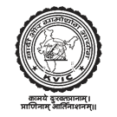


Khadi and Village Industries Commission (KVIC) MINISTRY OF MICRO, SMALL AND MEDIUM ENTERPRISES GOVERNMENT OF INDIA

Slide 2
WELCOME

Slide 3
Khadi and Village Industries Commission (KVIC)
Statutory body created by an Act of Parliament (No.61 of 1956)
Functions under the Ministry of Micro, Small and Medium Enterprises (MSME), GoI
Aims at generation of non-farm employment
Supports implementation of KVI programmes through various Central Sector Schemes
Objective
Function
Social Objective
Providing livelihood and employment
Economic Objective
Producing saleable articles by artisans
Wider Objective
Creating self reliance amongst the people
To plan, promote, facilitate, organize and assist in establishment and development of KVI.
To supply Raw Materials & Equipments
Marketing of KVI Products of the units
Research and Development, S&T
Training Artisans

Slide 4
KVIC Network: Departmental & Partner Infrastructure
Departmental Infrastructure
Structure of the Commission
CHAIRMAN
44 State/Divisional/ Sub Offices
06 Zonal Offices
18 Departmental Training Centers
26 Departmental Sales Outlets and its branches
05 Central Sliver Plants
ZONAL MEMBERS
EXPERT MEMBERS
EX-OFFICIO MEMBERS
North Zone
Science & Technology
Chairman, SBI / Deputy Managing Director
Partner Agencies
North East Zone
Marketing
34 States and Union Territories KVI Boards
2943 Registered Khadi Institutions
8061 Retail Sales Outlets including DSOs
Central Zone
CEO, KVIC
Rural Development
West Zone
FA, KVIC
East Zone
Technical Education & Training
South Zone
4.98 lakh khadi artisans employed
Around 9.13 lakh entrepreneurs assisted by providing employment opportunities to 73.70 lakh persons
Around 6.82 lakh persons trained during last nine years
Under Honey Mission around 1.92 lakh bee boxes distributed to 19288 beneficiaries.
Under Kumhar Sashaktikaran Programme around 27000 electric pottery wheels distributed to trained pottery artisans creating around 1.08 lakh employment

Slide 5
Performance of Khadi & Village Industries
(Rs. in crore & Employment in lakh Persons)
Sr. No | Particular | 2021-22 | 2022-23 | % increased
I. | PRODUCTION
a | Khadi, Polyvastra & Solarvastra | 2558.31 | 2915.83 | 13.97
b. | Village Industries | 81731.62 | 93040.84 | 13.84
 | Total - I | 84289.93 | 95956.67 | 13.84
II. | SALES
a. | Khadi, Polyvastra & Solarvastra | 5051.72 | 5942.93 | 17.64
b. | Village Industries | 110363.51 | 128686.56 | 16.60
 | Total - II | 115415.23 | 134629.49 | 16.65
III. | CUMULATIVE EMPLOYMENT
a. | Khadi, Polyvastra & Solarvastra | 4.97 | 4.98 | 0.20
b. | Village Industries | 162.64 | 172.14 | 5.84
 | Total - III | 167.61 | 177.12 | 5.67

Slide 6
Schemes and Programmes implemented by KVIC
Khadi Vikas Yojana (KVY)
Gramodyog Vikas Yojana (GVY)
Other schemes/ programmes
Modified Market Development Assistance (MMDA)
Interest Subsidy Eligibility Certificate Scheme (ISEC)
Work-shed Scheme for Khadi Artisans
Strengthening Infrastructure of Existing Weak Khadi Institutions and Assistance for Marketing Infrastructure
Science & Technology (Khadi)
Agro Based and Food Processing Industry (ABFPI) including Honey Mission
Mineral Based Industry (MBI) Kumhar Sashaktikaran Programme
Wellness and Cosmetic Industry (WCI)
Handmade Paper, Leather and Plastic Industry (HMPLPI)
Rural Engineering and New Technology Industry (RENTI)
Service Industry
Science & Technology (V.I)
Prime Minister's Employment Generation Programme (PMEGP)
Scheme of Fund for Regeneration of Traditional Industries (SFURTI)
Agro Based and Food Processing Industry (ABFPI) – Honey Mission
Mineral Based Industry (MBI) – Kumhar Sashaktikaran Programme
Wellness and Cosmetic Industry (WCI)
Handmade Paper, Leather and Plastic Industry (HMPLPI)
Rural Engineering and New Technology Industry (RENTI)
Science & Technology (V.I)

Slide 7
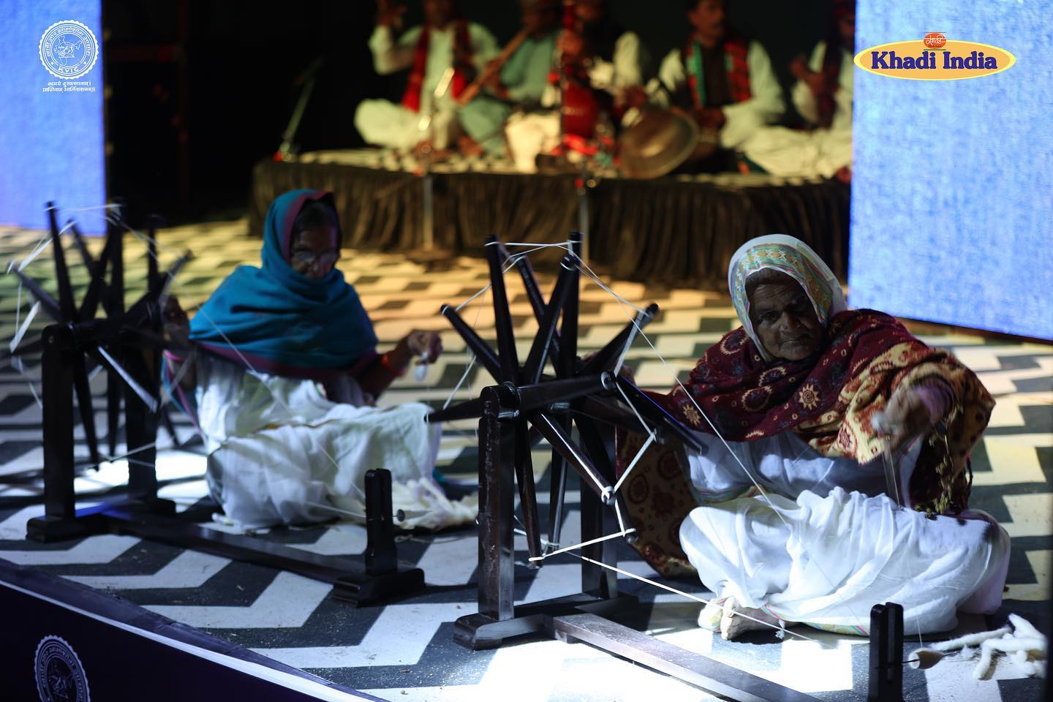
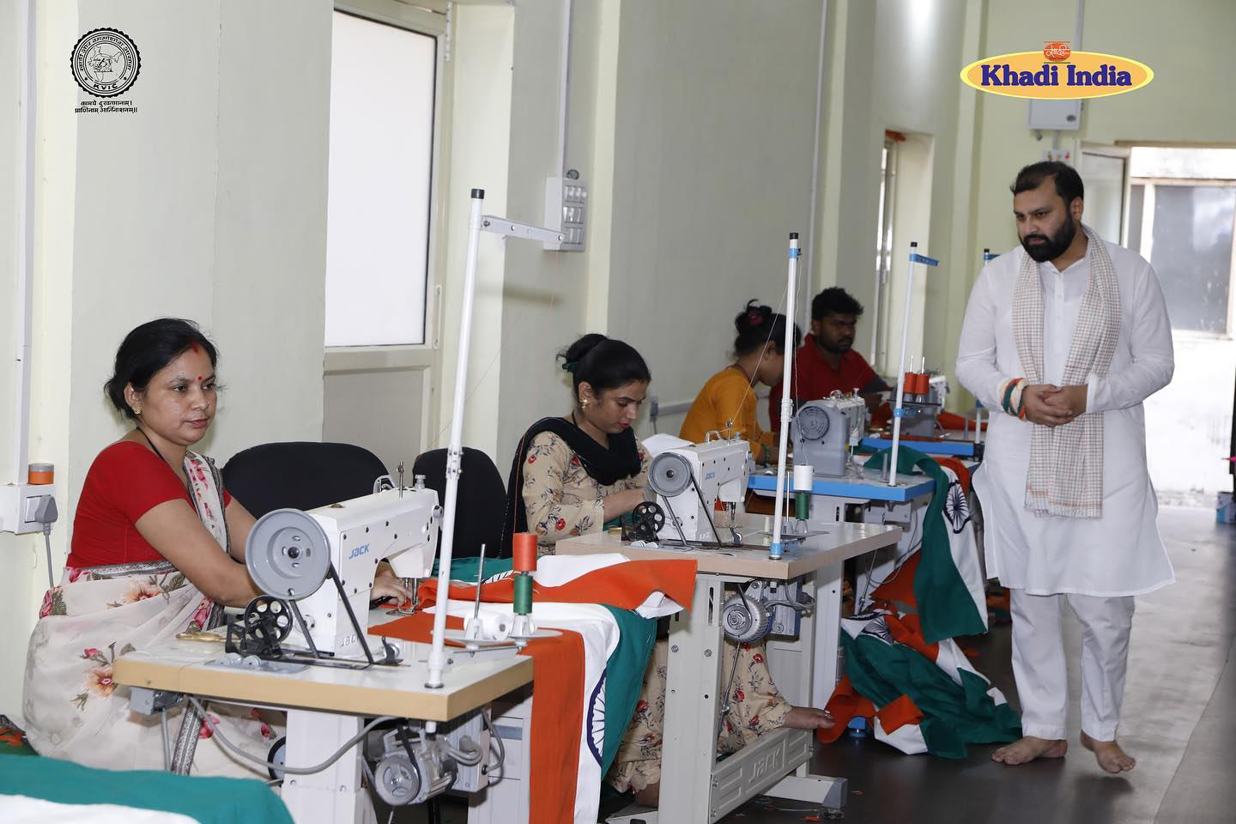
Khadi Vikas Yojana
Objectives
Eligibility criteria for registration of new KIs
To increase Khadi Production, Sales and no of artisans and employment
To improve Infrastructure for Khadi Production and also provide social security
To renovate and Modernize Sales Outlets and Marketing of Khadi
Registered under the Co-op. Society/Trust/Regd. Institution, etc. fulfilling the norms for taking up Khadi Activities any other under prevailing Act.
Infrastructure: Minimum 25 charkhas and 05 looms & 25 spinners, 05 weavers
Registration fee: Rs. 10,000/-
KVIC has started Registration of new Khadi Institutions online through KIRCS

Slide 8
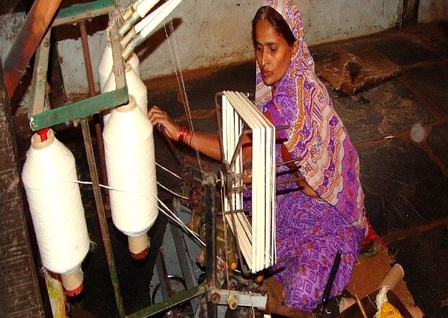
Khadi Vikas Yojana
Modified Market Development Assistance (MMDA): Assistance to the tune of @ 35% on Prime Cost for cotton Khadi, and @ 20% on Prime Cost for silk Khadi is provided.
49% of the assistance provided is passed on to the artisans through DBT.
Interest Subsidy Eligibility Certificate (ISEC) Scheme: KI’s can avail bank loan and pay only 4% interest and the difference between the actual lending rate and 4% is paid by GoI through KVIC as ‘Interest Subsidy’. This scheme facilitates availability of working capital.

Slide 9
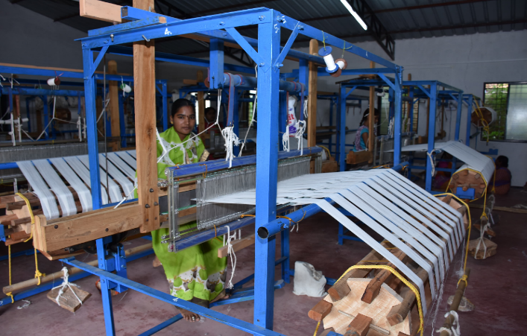
Khadi Vikas Yojana
Work-shed scheme for Khadi Artisans: The scheme envisages provision of sufficient space and congenial environment to artisans for smooth and fatigue free working. Financial Assistance: For Individual workshed (20 Sq. Mtrs): Rs. 1,20,000/- or 75% of the cost of workshed (90% for NER), whichever is less and for Group workshed (10 Sq. Mtrs per artisans): Rs.80,000 or 75% of the cost of the workshed (90% for NER), whichever is less.
Strengthening Infrastructure of Existing Weak Khadi Institutions and Assistance for Marketing Infrastructure: Assistance is provided to the weak Khadi institutions and also there is provision for renovation of Khadi Bhawans
Financial Assistance: Rs. 15.00 lakh - Weak Khadi Institutions to attain normalcy and Rs. 25.00 lakh KIs/DSOs/sales outlets of KVIBs to develop marketing infrastructure

Slide 10
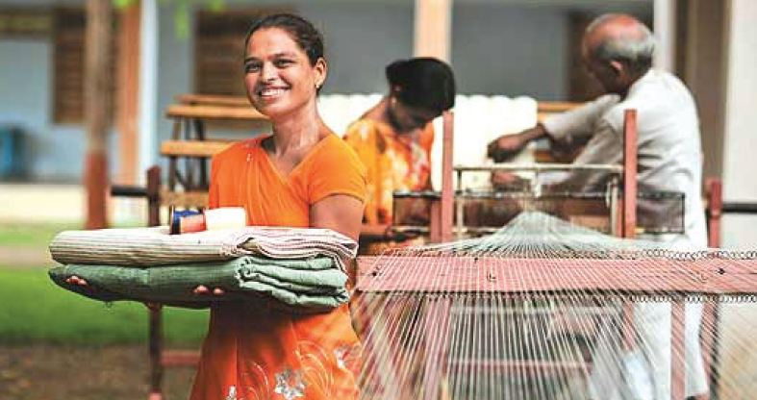
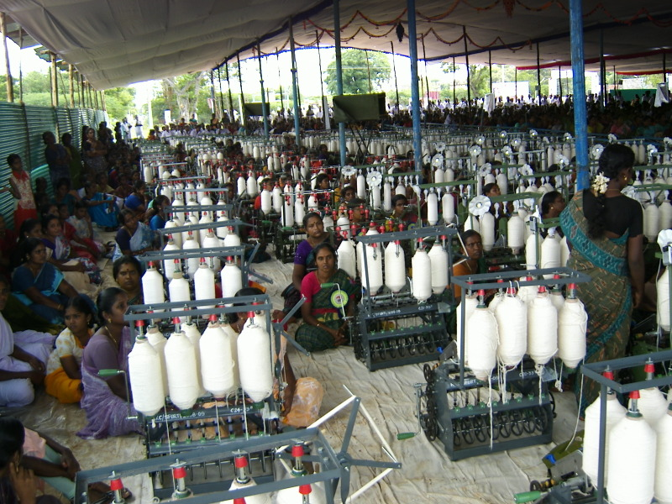
Khadi Artisans

Slide 11


Gramodyog Vikas
Yojana (GVY)
and
Other Schemes & programmes

Slide 12
Gramodyog Vikas Yojana (GVY)
Gramodyog Vikas Yojana (GVY)
An artisan centric programme - for revival of traditional and inherent skills of rural artisans
Encourage Village Industries having the strength of traditional heritage and indigenous skill
Imparting advanced skill development training along-with distribution of modern toolkits
Centers of Excellence (CoE) established for replication of successful business models for emulation by others.
Improving the standard of living of the rural artisans.

Slide 13
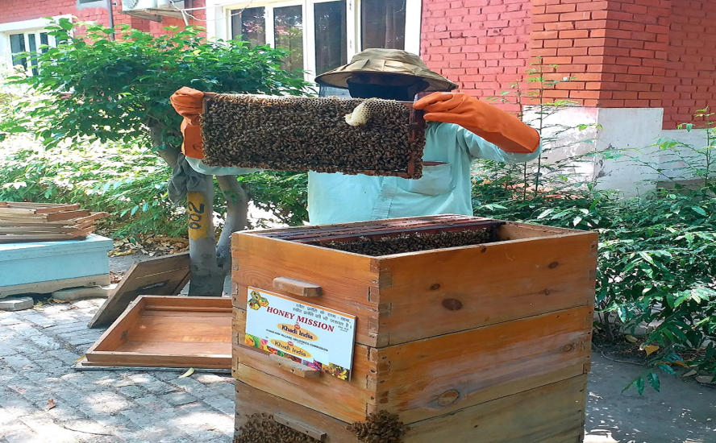
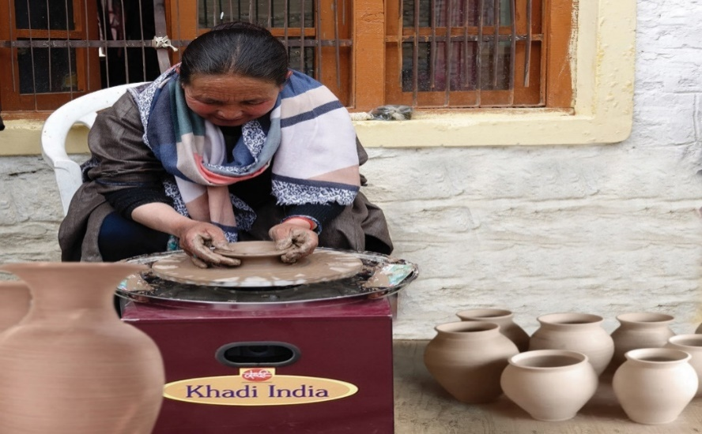
Gramodyog Vikas Yojana (GVY)
Honey Mission under GVY:
10 Bee-Boxes along with beehives and requisite training of 10 days duration is given to each beneficiary
The initiative has helped to supplement the income of farmers and unemployed youth of the country.
Under Honey Mission around 1.92 lakh bee boxes distributed to 19288 beneficiaries.
Kumhar Sashaktikaran Programme under GVY:
To uplift the rural pottery traditional artisan’s livelihood by enhancing their income.
Under this programme, skill up-gradation training of 10 days along with tools and energy efficient equipment viz. electric pottery wheels, clay-blunger and pugmill is provided.
Around 27000 electric pottery wheels distributed to trained pottery artisans creating around 1.08 lakh employment

Slide 14
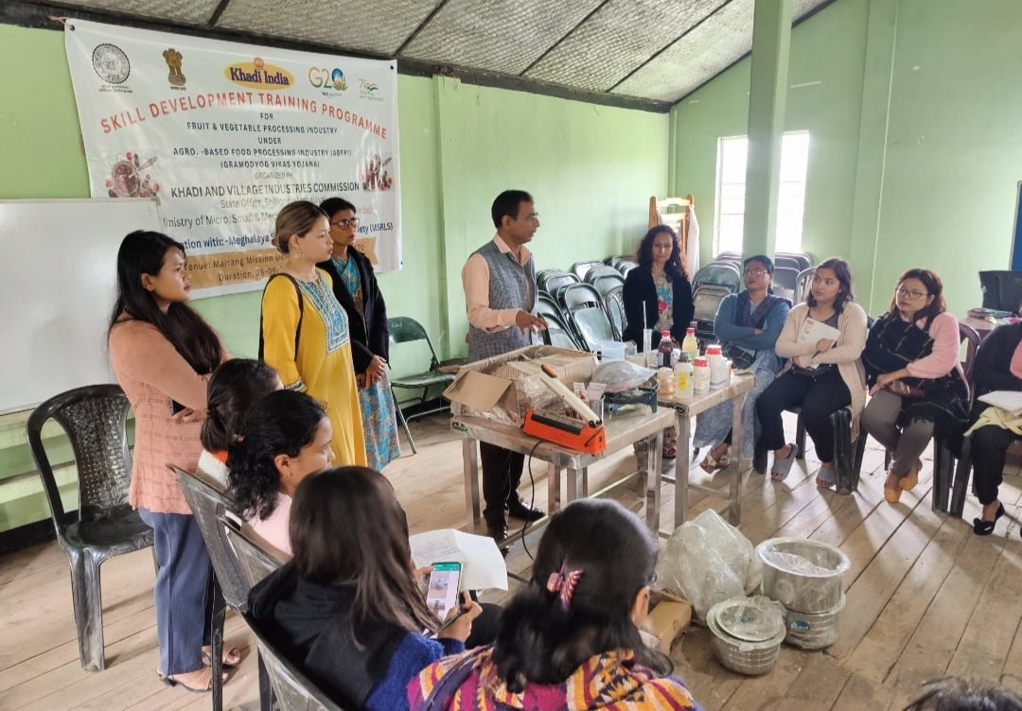

Gramodyog Vikas Yojana (GVY)
Agro Based Food Processing Industry under GVY:
Training along with tool kits are is provided in post- harvesting activities like Pulses & Cereals Processing Industry, Palm Gur and Khandsari Industry, Fruits and Vegetables Processing Industries, Village Oil Industry, Milk and Milk Based Industries etc.
Leather Industry under GVY:
Under the programme, 25 days skill development training provided to artisans in Footwear manufacturing/ repairing SHGs

Slide 15
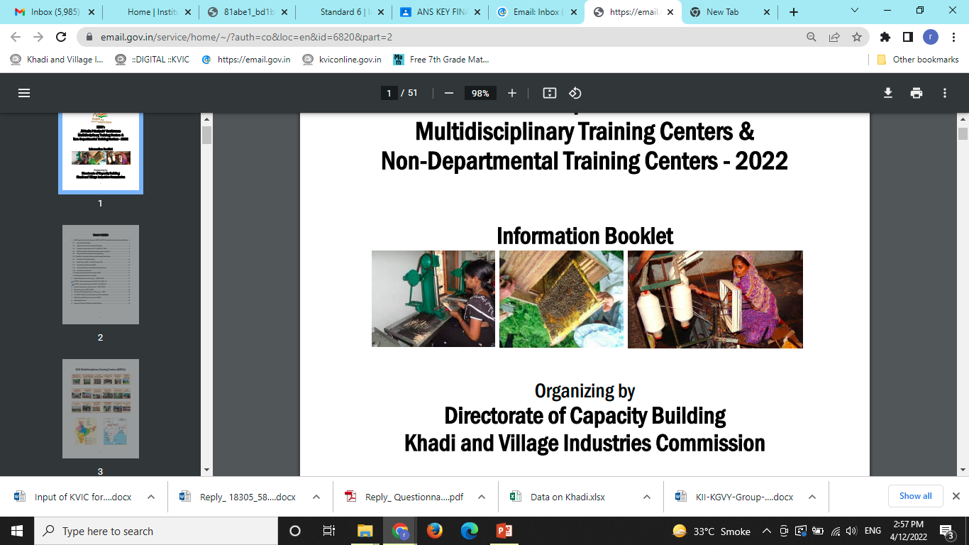
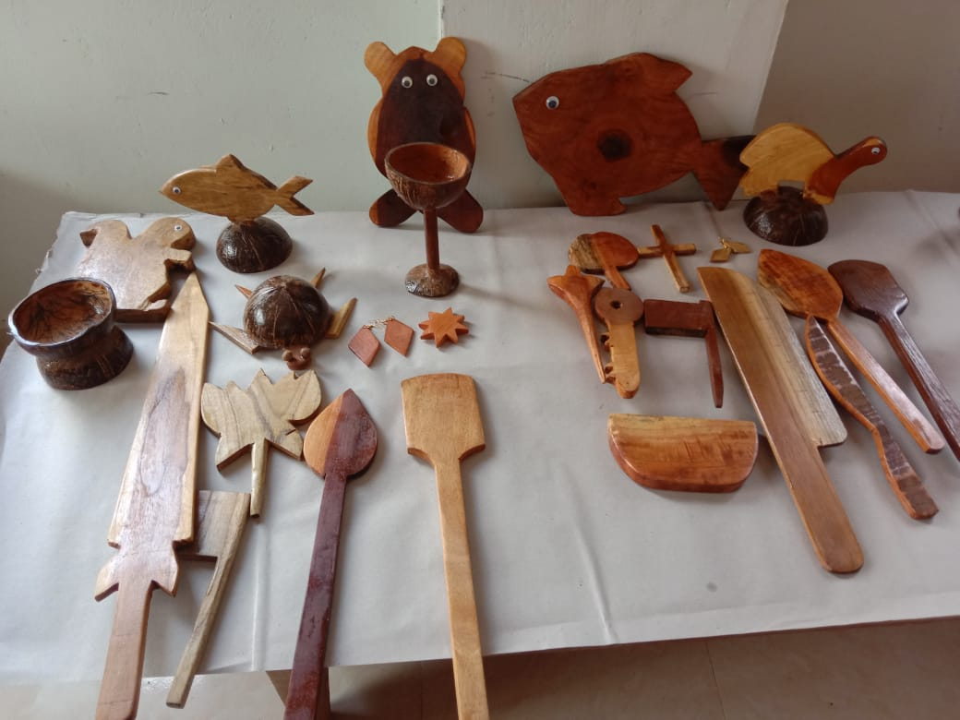
Gramodyog Vikas Yojana (GVY)
Agarbatti Programme under GVY:
Training (10 days), machines (Automatic and manual), toolkit and equipment is provided to individual beneficiaries/artisans
Waste Wood/ Turn Wood Craft/ Wooden Toy under GVY:
Under the programme, training and distribution of machine, tool kit and equipment is provided to individual beneficiaries/ artisan
Skill development training and modern Waste wood/turn wood Craft /Wooden toy related Machines and Tools and product development.

Slide 16
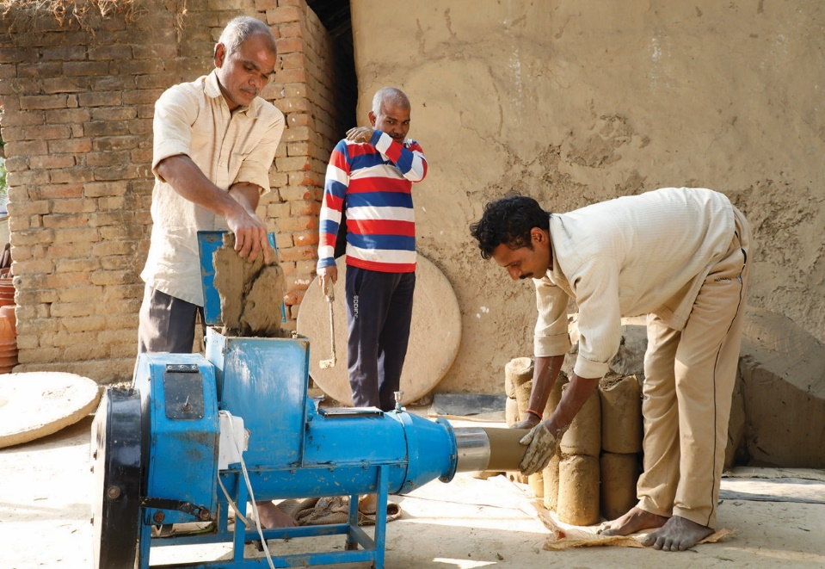
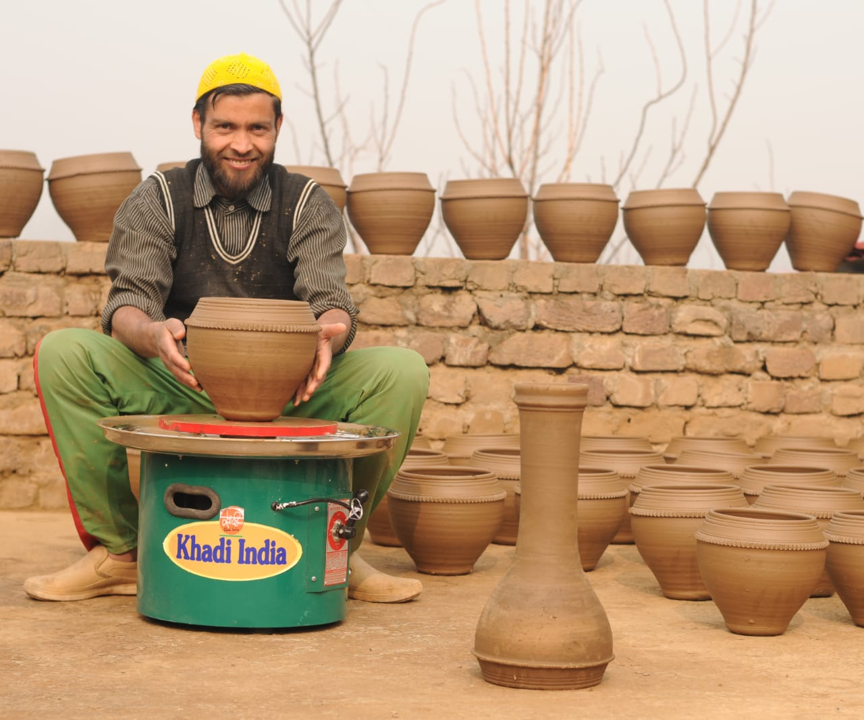
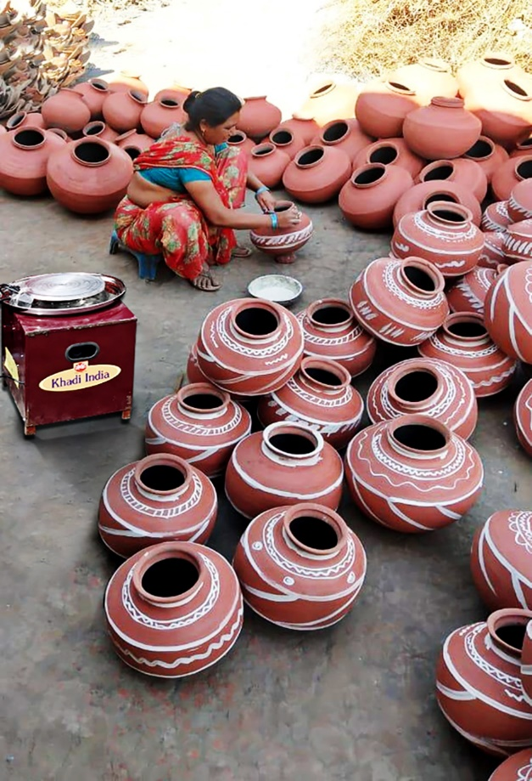
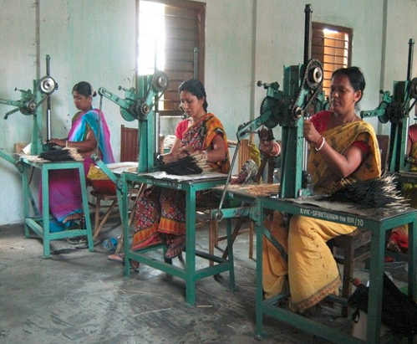

Slide 17
Prime Minister’s Employment Generation Programme (PMEGP)
It is a credit-linked subsidy programme launched on 15th August 2008 by Ministry of MSME for generation of employment opportunities through establishment of micro enterprises in rural as well as urban areas of the country
KVIC is the National Nodal Agency. The maximum cost of the project/unit admissible: Manufacturing Sector-Rs. 50.00 lakh & Service Sector - Rs. 20.00 lakh
2nd Loan for up-gradation of the existing PMEGP/MUDRA units: The maximum cost of the project under manufacturing sector for up-gradation is Rs.1.00 crore and Rs.25.00 lakh under business/service sector.
Rate of Subsidy (Assistance under PMEGP for setting up of Micro Units)
General category candidates | 15-25% (Urban-Rural)
SC, ST, OBC, Minorities, Women, Ex-Servicemen, Transgenders, Differently abled, NER, Aspirational Districts, Hill and Border areas, etc. | 25-35% (Urban-Rural)
Since inception (upto 31.03.2023) 8,69,359 entrepreneurs assisted and provided with Margin Money to the tune of Rs. 21870.18 crore and employment generated 73.672 lakh persons under PMEGP.

Slide 18
Scheme of Fund for Regeneration of Traditional Industries (SFURTI)
Scheme of Fund for Regeneration of Traditional Industries (SFURTI)
Objective
About
The main objective of the scheme is to organize traditional industries and artisans into clusters by increasing production and value addition to make products competitive and to promote traditional sectors and provide sustainable income to artisans.
Support up to Rs. 2.50 crore (Regular Cluster) for clusters up to 500 artisans and Rs. 5.00 crore (Major Cluster) for clusters with more than 500 artisans. Scheme implemented on the ground by Implementing Agencies (IAs)
NGOs, Central and State Govt. agencies – provide land & 5/10% contribution
IAs to constitute artisans into Special Purpose Vehicle (SPV)
Nodal Agencies (NAs) are national level institutes with sectoral expertise to supervise cluster implementation- 34 institutes empaneled under SFURTI as NA
Technical Agencies (TAs) engaged for each cluster in order to assist IAs in DPR preparation & project implementation
Sectors covered include handicrafts, handloom, khadi, coir, agro-processing, etc.
Notes:
Organizations/Institutions who can apply for SFURTI: Non-Government Organizations (NGOs), Institutions of the Central and State Governments, Semi-Government institutions, Field functionaries of State and Central Government, Panchayati Raj Institutions (PRIs).
Organizations/Institutions who can apply for SFURTI: Non-Government Organizations (NGOs), Institutions of the Central and State Governments, Semi-Government institutions, Field functionaries of State and Central Government, Panchayati Raj Institutions (PRIs).

Slide 19
Marketing
KVIC organizes domestic as well as international exhibitions to promote and popularize KVI products
Domestic exhibitions proved as a cost-effective medium for publicity
@ National-level, Zonal-level, State-level and District level and also special exhibitions, which were organized by other NGOs/ Govt. Departments on different occasions
KVIC undertakes Marketing activities through network of 8061 sales outlets:
8 DSOs “Khadi India” supported by their 18 branches
8035 Khadi sales outlets (KIs, KVIBs, etc.)
Khadi Lounges - New Delhi, Mumbai, Jaipur, Bhopal, Goa and Kevadia(Gujarat)
Khadi outlets at airports - Ahmadabad, Varanasi and Vishakhapatnam

Slide 20
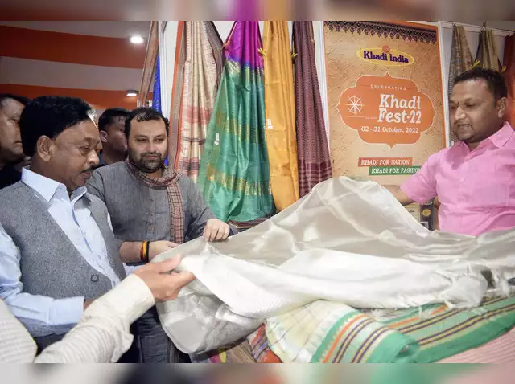

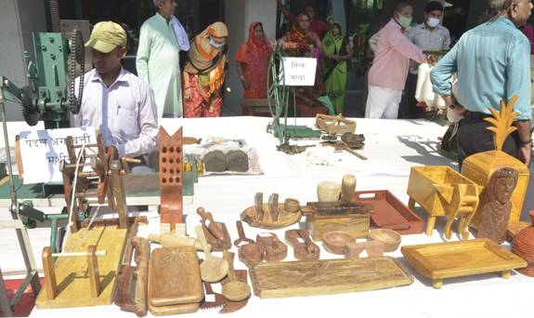
Marketing promotion (Exhibitions/fashion shows)

Slide 21
Capacity Building
Imparts need based training under various KVI disciplines
Objectives :
Skill Upgradation to persons engaged in KVI sector
Creating Entrepreneurial ecosystem
To create cadre of trained and skilled staff
Target group of beneficiaries:
Unemployed youths.
In-job Artisans/Supervisors working at Khadi and village industries institutions.
Prospective Entrepreneurs
Employees of KVIC, State KVIBs and KVI institutions.
PMEGP beneficiaries
INFRASTRUCTURE
I. Departmental Training Centres | 18
II. Non- departmental training Centres State KVI Boards Departmental Training Centre Training Centre Run by KVIC aided Institutions | 04 13
Total | 35
Duration
Short duration ranging from 1 week to 2 months
Few courses like Textile Chemistry are of long duration (06 months to 15 months)

Slide 22
Design Interventions
As a part of design development in Khadi sector, KVIC has set up CoEK alongwith NIFT based on Hub and Spokes Model.
The main hub center is at NIFT Campus, New Delhi and its four spokes centers at Gandhi Nagar, Bangalore, Shilong and Kolkata. This project focuses on:
Creation of new fabrics/ products based on season wise color forecast/fashion trends.
Disseminate quality standards for Khadi fabrics and clothing for high end domestic and global market.
Branding and publicity by creating interesting narratives around the new Khadi fabrics and products.
Create visual merchandising and packaging for new Khadi products.
Increase the global reach of Khadi by organizing or participating in Khadi Fashion shows and exhibitions.

Slide 23
KHADI MAHOTSAV
“ Wearing Khadi is a badge of honour ”
- Mahatma Gandhi ji
Repositioning Khadi

Slide 24
KEY ISSUES
Scientific approach to management of Khadi
Appropriate technology for future ready Khadi
Standardization of Khadi outlets and products
Digitization across the value chain of Khadi
Awareness building and participation of youth
Reinforce ‘vocal for local’, revive rural economy

Slide 25
Major Challenges
Diminishing artisan base and low incomes
Below par production and productivity
Standardization and quality assurance issues
Transparency in transaction and related issues
Marketing and Branding related considerations
Limited demand generation and customer focus
Regulatory framework out of sync with business

Slide 26
Artisan Base and Productivity
Enhancing artisan base by involving young entrepreneurs, SHG
Support for better productivity via technology, working capital
Value creation to make primary production more remunerative
Product Innovation: blended yarn, segment of kids, accessories
Broad-basing of institutional framework and process simplification

Slide 27
Standardization & Quality Assurance
Improving quality by diagnostic study and specific interventions
Capacity building of artisans and sansthas for quality production
Standards and quality assurance protocol for entire value chain
Independent testing and monitoring mechanism by third party
Standards and quality assurance protocol for village industry products
Customer feedback and two-way engagement mechanism

Slide 28
Branding and Marketing
Standardized Outlets : common branding, layout, digital connect
Increased footprint in the market : stores in malls, airports
Leveraging USP of Khadi : artisanal connect, sustainability
Special focus and dedicated systems for export promotion
Separate brand strategies for (a) high end and (b) economy
Partnership with private enterprise and infusion of capital

Slide 29
Digitalization and Institutional Framework
Online management of supply chain and transactions
E-commerce platform with support for logistic, on boarding
Full integration with e-commerce platforms like GeM, ONDC
Strategic focus on advocacy, creation of protocol, ecosystem
Specialized mechanism for handling operations and marketing
Remodel institutional framework to suit contemporary needs

Slide 30
THANK YOU

